Slide 1


Machine Learning
TEAM 6
PRESENTATION

Slide 2
AGENDA
Concept of PCA
Relation between PCA and SVD
Concept of LDA
Concept of LDA - between class variance
Concept of LDA - within class variance
Implementation of LDA in python

Slide 3
Concept of PCA
Principal Component Analysis (PCA) is a statistical technique used for data
reduction without losing its properties. Basically, it describes the composition of variances and covariances through several linear combinations of the primary
variables, without missing an important part of the original information.
IMPORTANT TERMS
* Variance
* Covariance
* Eigen Vectors and Eigen Values
* Principal Components

Slide 4
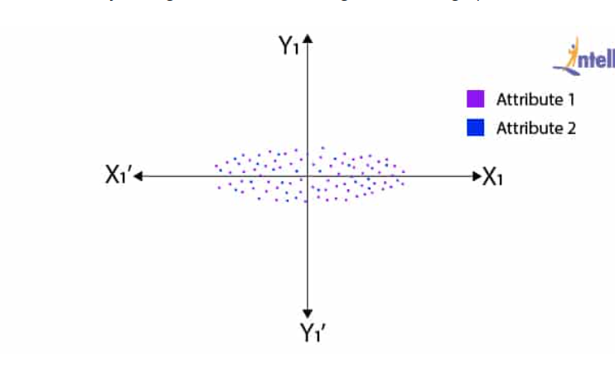
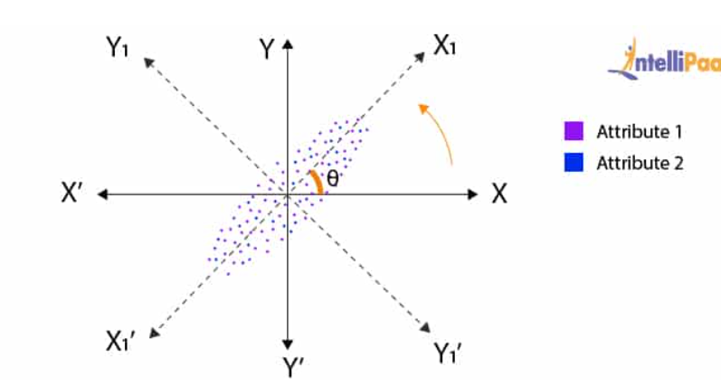


Slide 5
Steps For Calculating PCA
Find mean
Compute the covariance matrix for the data variables
Computing the eigenvectors and eigenvalues and order them in descending order
Then, calculate the Principal Components

Slide 6
APPLICATION OF PCA

Slide 7
Applications
Neuroscience
Facial Recognition
Image and Video compression
Healthcare Models
Noise Reduction

Slide 8
Relation between PCA and SVD

Slide 9
ASPECT | PCA | SVD
Objective and Purpose | PCA works by identifying the most important patterns in the data and reducing the number of features used in a model. | SVD works by breaking down a matrix into its constituent parts and selecting the most important components.
Matrix Input | Typically operates on the covariance matrix of data | Can be applied directly to the original data matrix
Mathematical Representation | Involves the eigenvector decomposition of the covariance matrix | Involves decomposing the original matrix into three matrices: U, Σ, and V^T
Applications | visualize multidimensional data reducing noise in image resize an image | recommendation system data compression image compression

Slide 10
ASPECT | PCA | SVD
Computational Complexity | PCA computations can be more efficient for large datasets due to the covariance matrix's smaller size | SVD can be computationally expensive for large datasets due to its full matrix decomposition
Data Scaling and Centering | Data may need to be centered (mean subtraction) and scaled (standardization) for PCA to work effectively | SVD does not require data scaling or centering as it operates directly on the data matrix
Usage in Data Reduction | used for reducing the dimensionality of data by selecting a subset of principal components | Useful for data reduction through truncation of singular values and corresponding singular vectors
Implementation in Libraries | To implement PCA Using the libraries are NumPy, SciPy, scikit-learn. | To implement SVD using the libraries are NumPy, scikit-learn.

Slide 11
Concept of LDA
Linear Discriminant Analysis (LDA) is one of the commonly used dimensionality reduction techniques in machine learning to solve more than two-class classification problems. It is also known as Normal Discriminant Analysis (NDA) or Discriminant Function Analysis (DFA).
LDA works by projecting the data onto a lower-dimensional space that maximizes the separation between the classes. It does this by finding a set of linear discriminants that maximize the ratio of between-class variance to within-class variance. In other words, it finds the directions in the feature space that best separate the different classes of data.
LDA assumes that the data has a Gaussian distribution and that the covariance matrices of the different classes are equal. It also assumes that the data is linearly separable, meaning that a linear decision boundary can accurately classify the different classes.

Slide 12
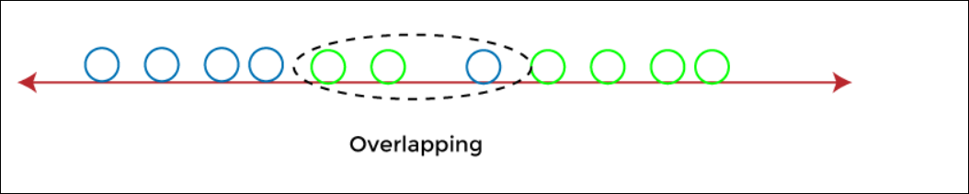
For e.g., if we have two classes with multiple features and need to separate them efficiently. When we classify them using a single feature, then it may show overlapping.
To overcome the overlapping issue in the classification process, we must increase the number of features regularly.

Slide 13
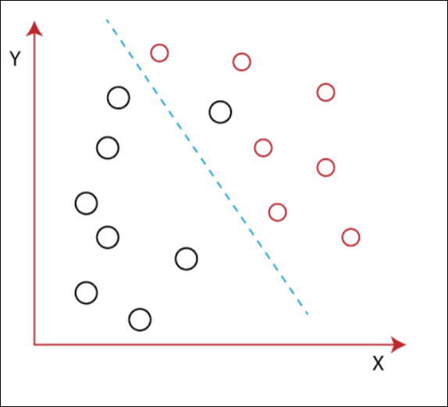
Let's assume we have to classify two different classes having two sets of data points in a 2-dimensional plane as shown below image:
However, it is impossible to draw a straight line in a 2-d plane that can separate these data points efficiently but using linear Discriminant analysis; we can dimensionally reduce the 2-D plane into the 1-D plane. Using this technique, we can also maximize the separability between multiple classes.

Slide 14
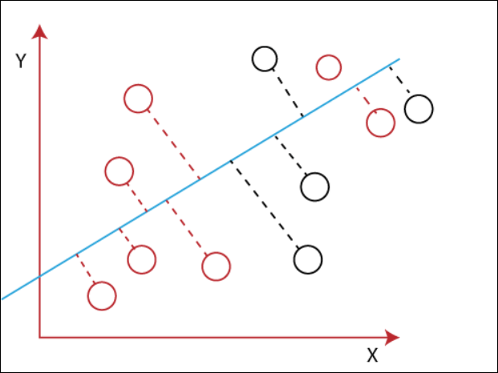
Linear Discriminant Analysis (LDA) works
It maximizes the distance between means of two classes.
It minimizes the variance within the individual class.
Using the above two conditions, LDA generates a new axis in such a way that it can maximize the distance between the means of the two classes and minimizes the variation within each class.

Slide 15
Advantages:
It is a simple and computationally efficient algorithm.
It can work well even when the number of features is much larger than the number of training samples.
It can handle multicollinearity (correlation between features) in the data
Limitations:
It assumes that the data has a Gaussian distribution, which may not always be the case.
It assumes that the covariance matrices of the different classes are equal, which may not be true in some datasets.
It assumes that the data is linearly separable, which may not be the case for some datasets.
It may not perform well in high-dimensional feature spaces.

Slide 16
CONCEPT OF LDA BETWEEN CLASS VARIANCE
av

Slide 17
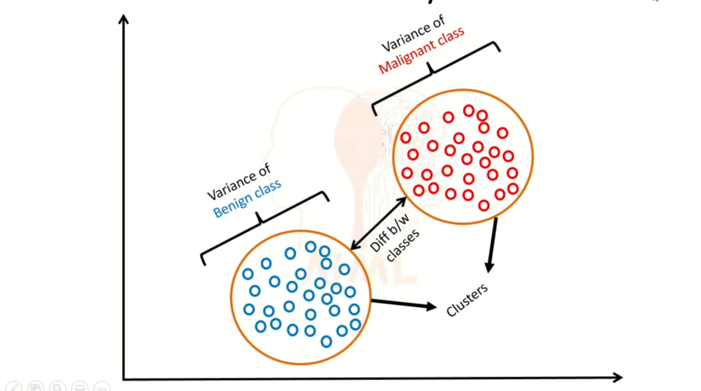
av

Slide 18
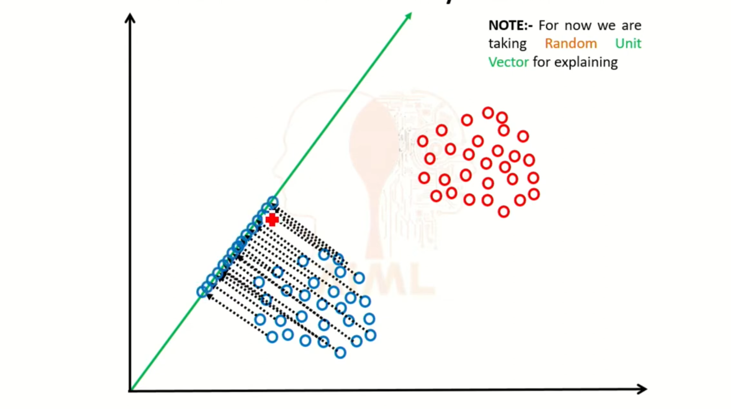
av

Slide 19
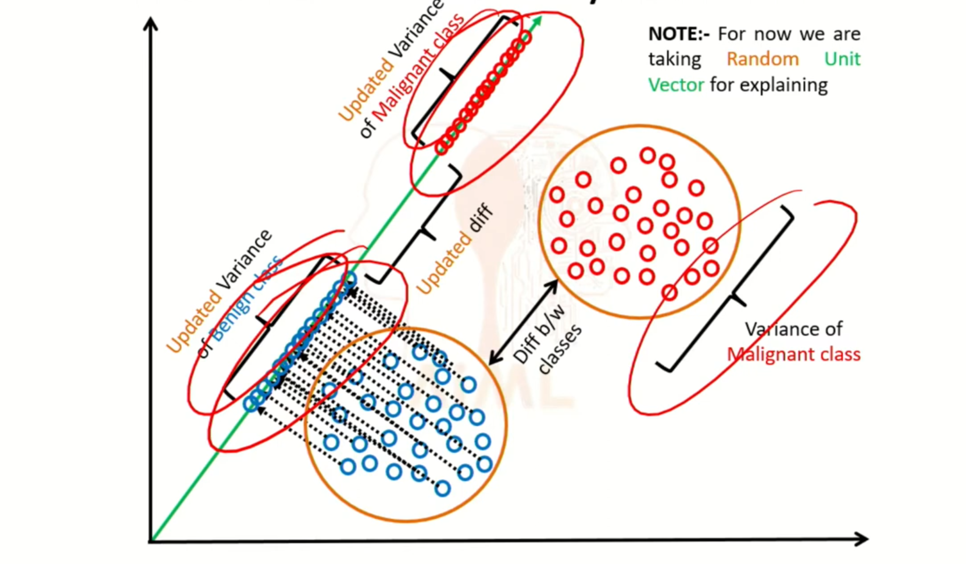
av

Slide 20
LDA BETWEEN CLASS VARIANCE
Between-class variance, also known as between-class scatter or between-class spread, is a statistical measure used in Linear Discriminant Analysis (LDA) and other classification techniques to assess the separation or spread of data points belonging to different classes. It quantifies the degree to which data points from different classes are dispersed or separated in a multi-dimensional feature space.
.
av

Slide 21
LDA BETWEEN CLASS VARIANCE
Centroids or Class Means: To compute between-class variance, you begin by calculating the centroids or class means. For each class, you determine the mean (average) of the feature vectors of data points within that class. These centroids represent the central tendency of each class within the feature space.
Overall Mean: You also calculate the overall mean, which is the mean of all the feature vectors in the entire dataset, regardless of their class labels. This point represents the center of the entire dataset.
Distance Between Class Centroids: For each class, you measure the Euclidean distance (or other distance metric) between the centroid of that class and the overall mean. This distance reflects how far apart the centroid of each class is from the center of the entire dataset. The greater the distance, the better the separation between classes.
Between-Class Variance: To obtain the between-class variance, you combine these distances. One common way to do this is by summing the distances from each class centroid to the overall mean. The formula for between-class variance might look like this:
Between-Class Variance = Σ (Number of Data Points in Class) × (Distance from Class Centroid to Overall Mean)²
av

Slide 22
EXAMPLES
Iris Flower Classification:
In the famous Iris dataset, you have three species of iris flowers: setosa, versicolor, and virginica.
You want to use LDA to classify these iris species based on features like sepal length, sepal width, petal length, and petal width.
The between-class variance in this case would quantify how well the means of these three classes are separated from each other.
Image Classification:
In image classification tasks, you might have multiple classes for different objects or scenes, such as cats, dogs, cars, and mountains.
Features could be pixel values or deep learning embeddings.
Between-class variance would assess how well the visual characteristics of different classes are distinguished, facilitating image classification.
av

Slide 23
WHY MAXIMIZE
Enhanced Class Separation
Noise Reduction
Improved Discriminative Power
Simpler Models
Dimensionality Reduction
Reduced Overlapping Regions
av

Slide 24
USES OF LDA – B/W Variance
Feature Selection
Classification
Pattern Recognition
Exploratory Data Analysis
Data Visualization
av

Slide 25
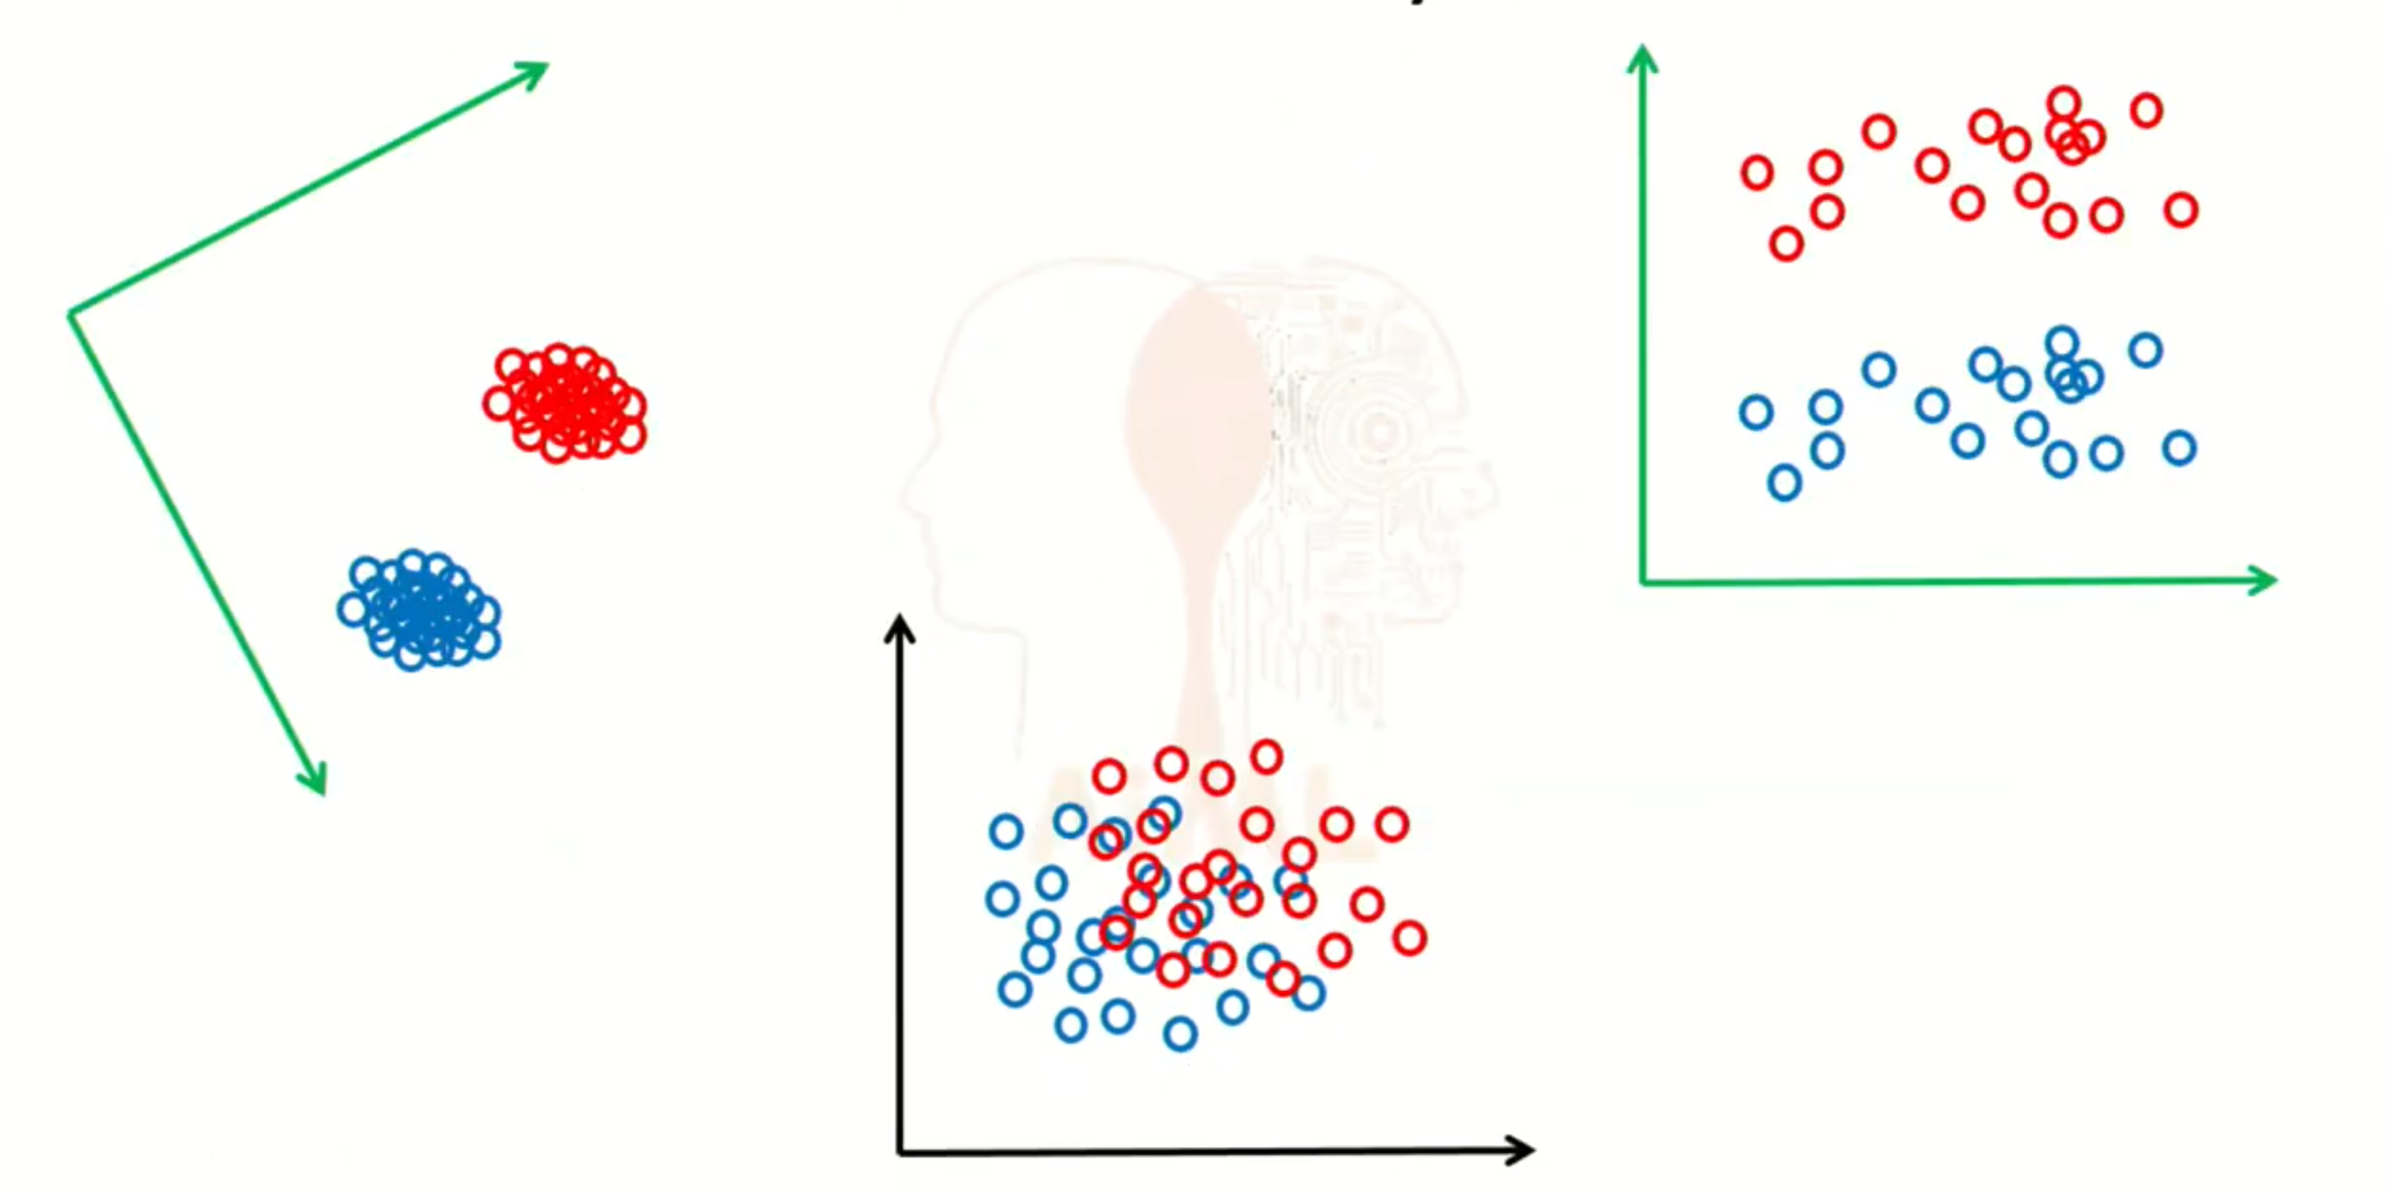
av

Slide 26
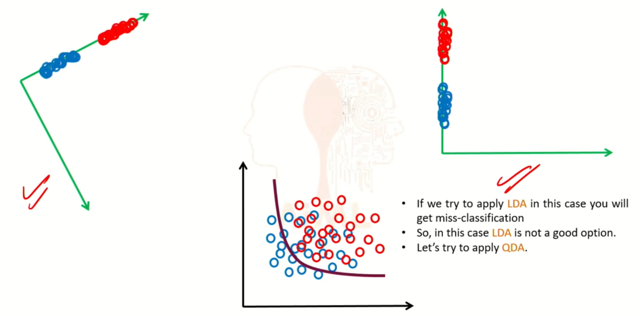
av

Slide 27
QDA
QDA, or Quadratic Discriminant Analysis, is a classification technique closely related to Linear Discriminant Analysis (LDA). Both LDA and QDA are used for supervised classification, but they differ in terms of their assumptions about the underlying data distribution and the decision boundaries they create.
av

Slide 28
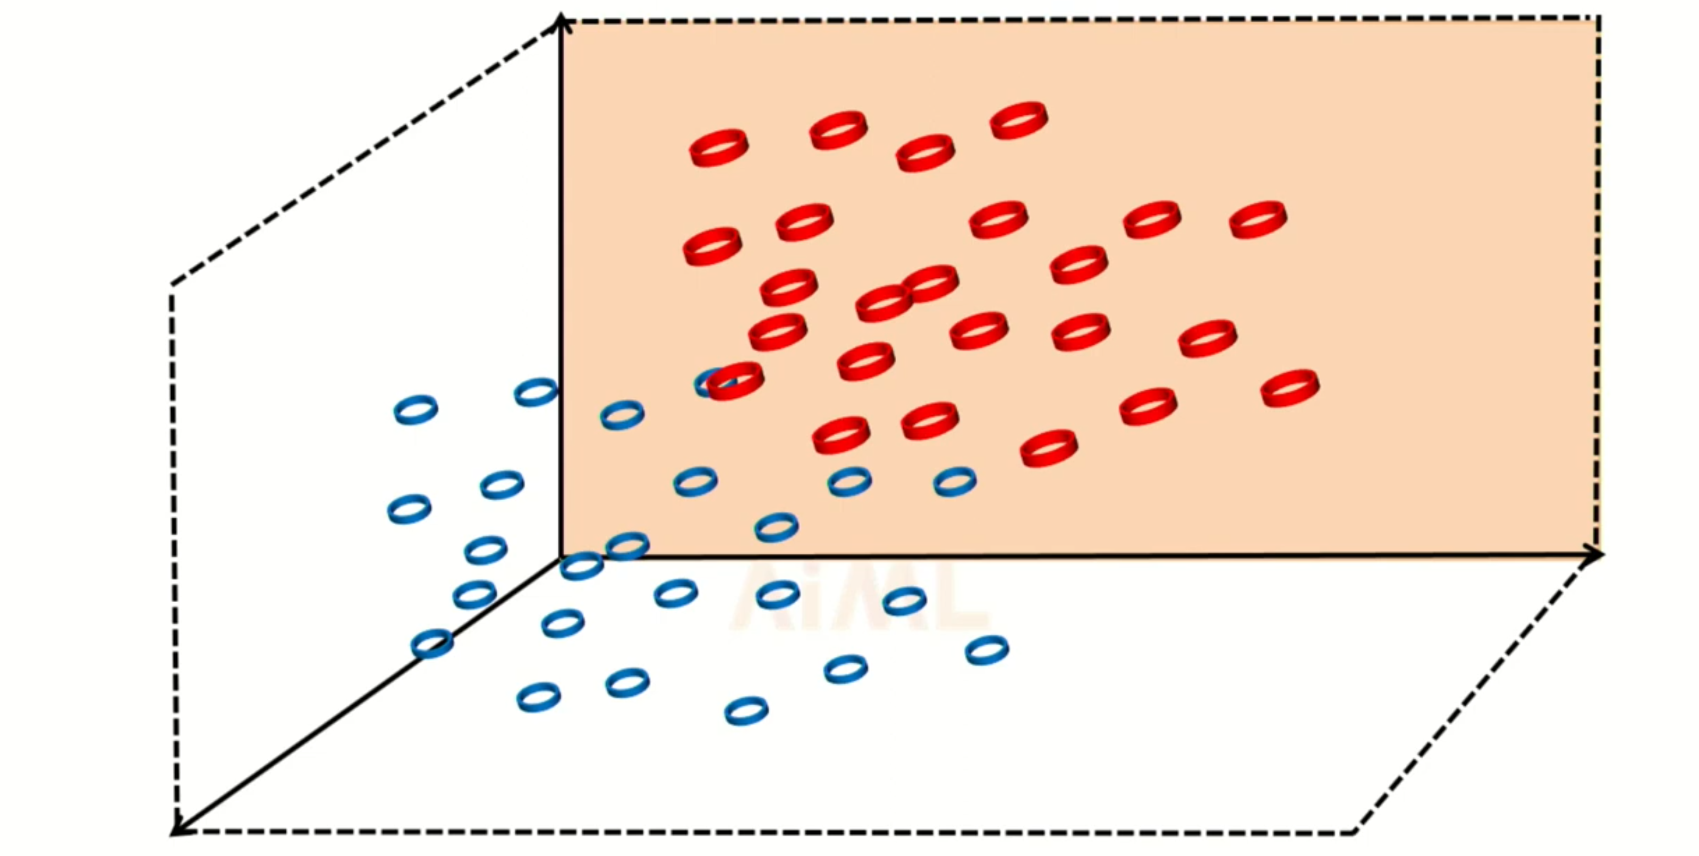
av

Slide 29
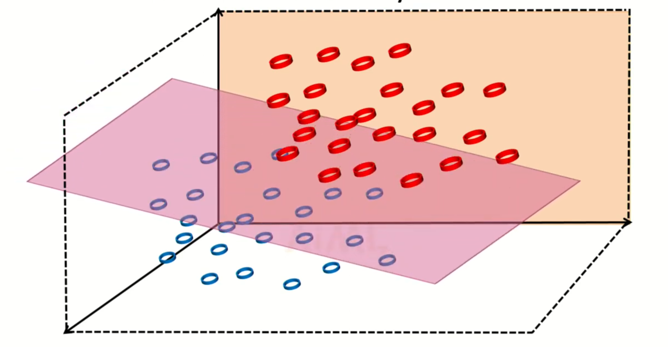
av

Slide 30
CONCEPT OF LDA WITHIN CLASS VARIANCE
av

Slide 31
LDA WITHIN CLASS VARIANCE
LDA is a dimensionality reduction technique commonly used in machine learning and statistics, particularly for classification problems. Its primary goal is to maximize the separation between different classes while minimizing the variance within each class.
"classification problem" refers to the task of assigning a category or class label to an object or observation based on its characteristics or features

Slide 32
why minimize the variance?
If you minimize the variance within each category, it means that all the fruits within the same category will be very similar to each other. For example, all apples will be very much alike in terms of weight and color.
Why Projecting onto Lower Dimension?
Imagine you have a 3D picture, like a sculpture, and you want to show it on a flat piece of paper. To do that, you might project the 3D image onto the 2D paper, which means making it flat.
Let's say you have a lot of information about fruits, like weight, color, size, texture, taste, and more. Using a dimensionality reduction technique, you can focus on the most important things (e.g., weight and color) and ignore less important details.

Slide 33
VARIANCE AND CLASS IN CONTEXT OF “LDA”
Variance measures how spread out or scattered data points are within a group or category. In simpler terms, it tells us how much the data points within a group differ from each other.
Low variance means that the data points in a group are very similar and close to each other, while high variance means that the data points are more spread out and different from each other.
"class" represents a group or category of items that you want to distinguish from other groups. It's like sorting things into different boxes based on certain characteristics.

Slide 34
EXAMPLE
Fruit Classification
Suppose you have a dataset with three types of fruits: apples, bananas, and oranges. You want to use LDA to distinguish between these fruits based on their weight (in grams) and color (red, yellow, orange).
Let's focus on the "apples" class. You measure the weight and color of several apples.
If the apples have low variance in weight and color, it means they are very similar to each other. For example, all apples are around 150 grams and are red.
Low variance within the class suggests that apples are similar in weight and color.

Slide 35
WORKING
I. Data Preparation:
You start with a dataset that contains samples belonging to multiple classes.
Each sample has multiple features (attributes).
II. Within-Class Variance:
LDA focuses on reducing the variance within each class. This means that it tries to make the data points in the same class as close to each other as possible.
The idea is to ensure that the samples within a class are more similar to each other than to samples in other classes.
III. Between-Class Variance:
LDA also aims to maximize the variance between different classes. It wants to make sure that the different classes are well-separated from each other in the reduced-dimensional space.
IV. Projection onto Lower Dimensions:
LDA then projects the data onto a lower-dimensional space while preserving both the within-class and between-class variance.
This lower-dimensional space is usually one or more dimensions (depending on the number of classes).

Slide 36

Implementation of
Linear Discriminant Analysis
Using Python

Slide 37
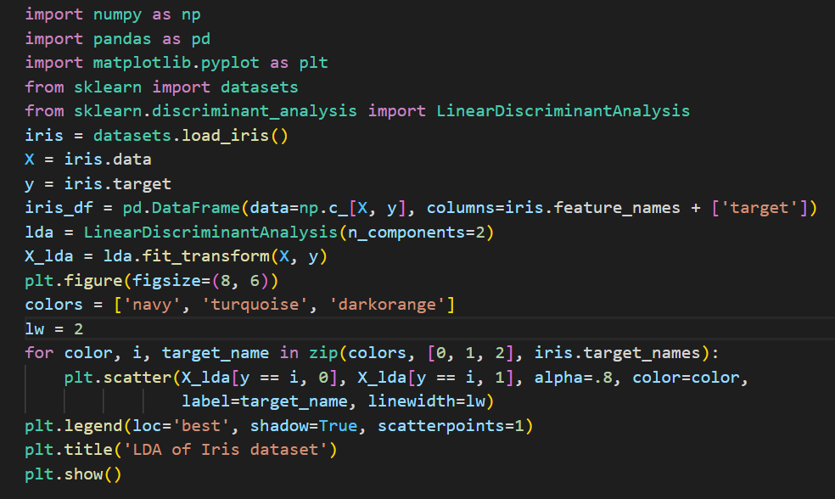

Slide 38
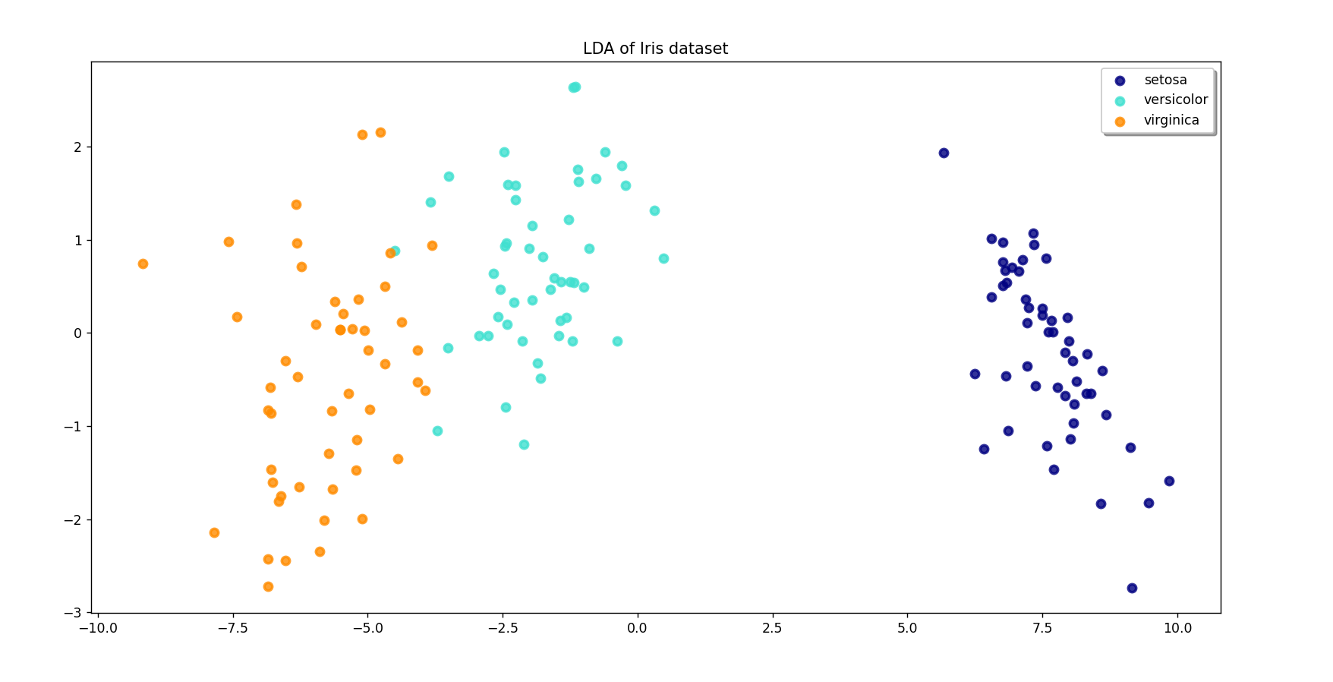
Output:

Slide 39
Applications of
Linear Discriminant Analysis

Slide 40
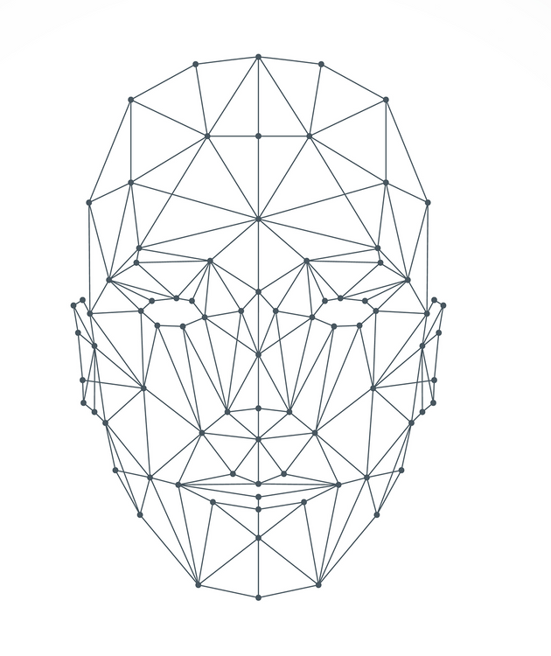
Computer Vision:
Face Recognition:
LDA is used to extract discriminative features for identifying individuals in images or videos.
Object Recognition:
LDA can help classify and distinguish objects in images or videos, making it valuable in computer vision tasks.

Slide 41

Natural Language Processing (NLP):
Text Classification:
LDA can be applied to categorize text documents into different topics or sentiment classes.
Document Clustering:
LDA is used to group similar documents together based on their content.

Slide 42

Medical Imaging:
Tumor Detection:
LDA can aid in the detection of tumors or anomalies in medical images like mammograms.
Quality Control:
Manufacturing:
LDA is employed in manufacturing to separate products into categories like "defective" and "acceptable" based on quality measurements.

Slide 43

Sports Analytics:
Game Strategy:
It can help in analyzing opponent strategies and
optimizing game plans.
Environmental Monitoring:
Air Quality Analysis:
LDA can assist in classifying air quality data into different pollution levels, aiding in environmental protection efforts.

Slide 44


